Slide 1

Supply Chain Management
INFO 5100 APPLICATION ENGINEERING DEVELOPMENT
Presented by:
Aishwarya Venkatesan
Sivaranjani S
Ashwin Kumar

Slide 2
Table Of Contents
Overview
Understanding the flow
Project objective
Target audience
Market trends
Advanced Features

Slide 3
Overview
This is a tool based on the broker model of business. This tool is useful for the organizations who are usually involved in cross border shipments as a daily part of the business. With enormous amounts of daily movement of material to cross border, usually the cargo is on heavy weighting time or unattended without knowing the details like proper documentation, ETA (Estimated time of Arrival/Pickup) or ETD (Estimated time of Departure or Delivery).
To lean the whole sequence and remove the brokers involved in between a buyer and seller, this tool will guide both buyer and seller to work in sync in spite of being in various ERP (Enterprise Resource Planning)
The brokers involve from the early stage of start of shipment till the delivery like (pick up executer, outbound custom broker, outbound agent, port agents, shipping booking agent, inbound port agents, inbound agent, inbound custom agent, inbound custom broker and collection agent.

Slide 4
Understanding the Supply Flow
01
For any supply chain to start, there is a PO to the start of the workflow in the ERP at the Buyer and the confirmation in terms of an invoice from the Seller.
02
The Supply starts post the agreement of the documents which are mutually signed by the stakeholders to continue. Based on the locations of the parties, the respective middlemen here the Shippers are allotted.
03
Once the middle ground vendors are selected, the containment is executed to the next mover as and when that they are received and pushed as a chain
04
Understanding the nature of the shipment, it goes for the custom clearance and to a cross border shipper who takes the same and delivers on other land where the customs is ready for an audit.
05
The clearance agents are then placed at the respective locations for ensuring the documentations are valid and clearance and shipping is performed to the end customer.

Slide 5
Project objective
This tool focuses on elimination of middlemen/broker/agents in a shipping senario to a minimalist way which ensures faster communication and clearance of road blocks directly for the end customers in any type of delay caused in the supply chain process. Overall ensure zero time on follow-ups and rework conditions

Slide 6



Target audience
This tool focuses on a global perspective manufacturers, buyers, sellers, distributors, shippers, 3rd party labelers etc.

Slide 7
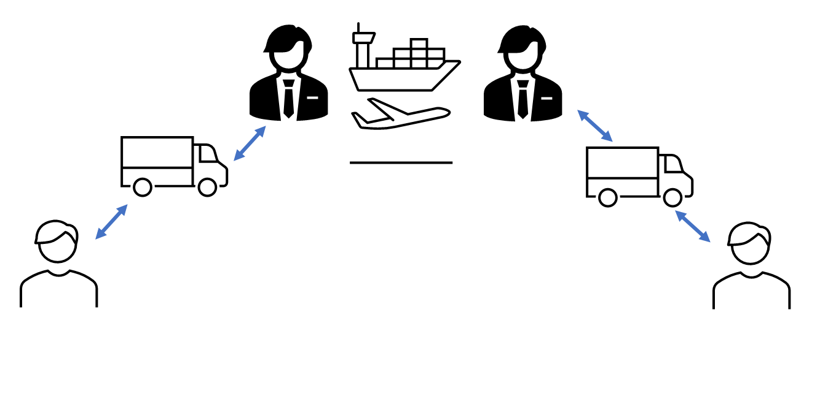

Slide 8
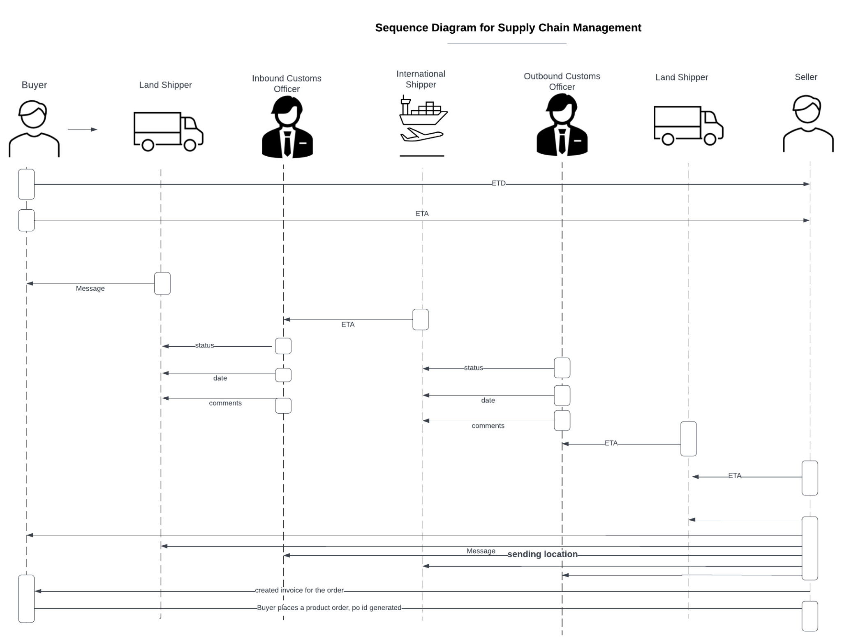
Sequence Diagram

Slide 9
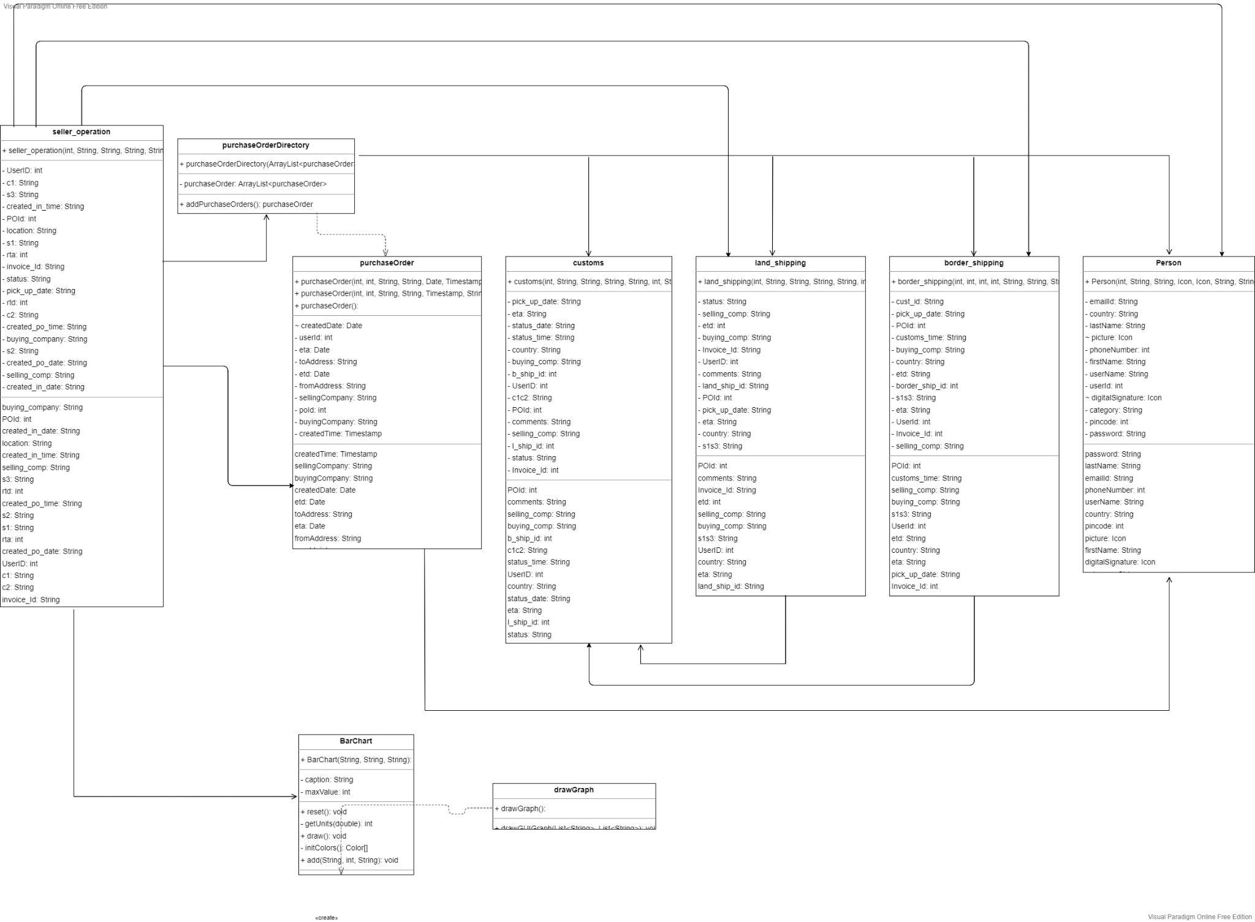
Class Diagram

Slide 10
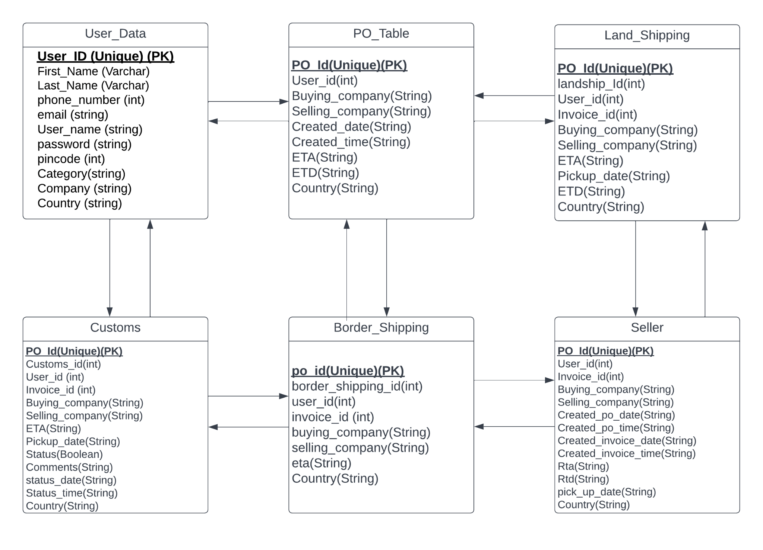
ER

Slide 11
Further Developments
Smart Contracts with document upload and digital signature
Document tracking and version control
Model Lawyers
Model Finance Team
Model ERP based plugin
Model government based organizations
Taxation and savings
An application on go to track orders and order status
Process variation with the type of supply workflow incoterms (EXW, DAP, DDP & CIF)
Entry to block chain

Slide 12

Thank you!

